Slide 1
Big Mountain Resort Profit Margin Retention Plan
Aim: To provide evidence of the best suitable method for Big Mountain Resort to implement in order to maintain their current profit margin.
With the installation of a chairlift, operational cost has increased by $1.54million this season.
Big Mountain Resort needs to maintain or exceed a profit margin on 9.2%.
focusing on mutable features of the resort.
Which strategies can Big Mountain Reosrt Implement?
By Amit Bharadwa

Slide 2
Key Findings
Adult admission price of $64.07 is suitable for current operations.
With a current price of $81.00 and an average of 350,000 customers,operational costs of the chair lift will be covered.
Additional strategies to increase revenue for the resort.

Slide 3
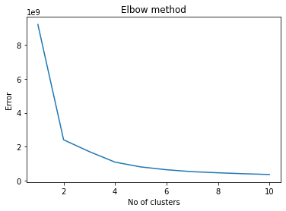
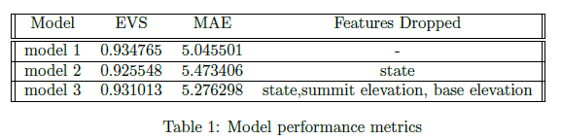
Modelling
Clustering
With the use of the unsupervised classification algorithem, K-means clustering, unknown patterns were identified.
The k parameter 3 proves to be the most suitable which can be seen in figure 1 below.
Machine Learning Model
Model the predicted value for the adult admission price using linear regression model.
By comparing immutable features of the resort, model 3 was chosen from table 1, which is based on model performance metrics.
Figure 1: Elbow plot showing optimum number of clusters.

Slide 4
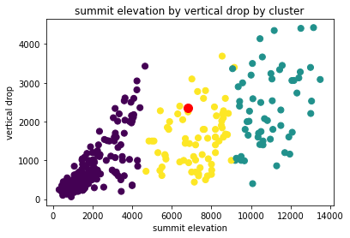
Results
In terms of immutable features, Big Mountain Resort falls in the second cluster which is identified from figure 2 below as the red circle.
From the linear regression machine learning model, a predicted value of $64.07 is suitable for current operations.
The greatest influence which can be seen as the coeffcient amoungst all the features proved to be the adult weekday price.
Figure 2: Red circle identifying Big Mountain Resort compared to other resorts in the USA.

Slide 5
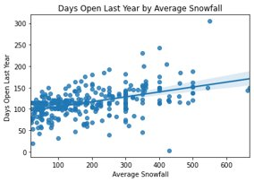
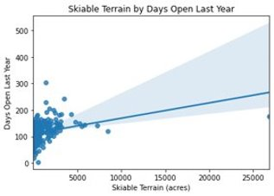
To increase company revenue , the resort needs to stay open for more days throughout the season.
From Figure 3, it can be seen with an increase in skiable terrain and average snowfall the resort can stay open for longer.
(a)
(b)
Figure 3: (a) Relationship between snowfall and the days open last year. (b) Relationship between skiable terrain and days open last year.

Slide 6
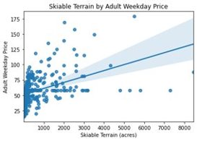
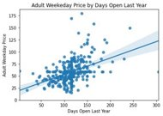
Comparing relationships between other resorts, skiable terrain and admission ticket price. With a larger area per acre, the resort is able to charge a higher price. This can be justified by figure 4a.
Figure 4b shows how the increase in days open correlates to the price of admission.
(a)
(b)
Figure 4: (a) Relationship between admission and skiable terrain. (b) Relationship between admission and days open last year.

Slide 7
Summary
With the current price of $81, price of addmission will cover operational costs of the new chairlift.
Focusing on other features of the resort such as skiable terrain and average snowfall will allow increase the number of days the resort will stay open and thereby bring in a higher revenue.
For future work, futher analysis can be done on how much snow the resort needs to produce.

